Slide 1


Evolving AI Neural Network with NeuroEvolution of Augmenting Topologies
Dev Mistry
School Of Emerging Sciences
Gujarat University
Navrangpura,
Ahmedabad

Slide 2
Introduction
How to benefit from evolution is a crucial subject in evolving neural networks. A technique called NeuroEvolution of Augmenting Topologies (NEAT), which performs better than the top fixed-topology approaches.
Efficiency is increased by
(1) applying a systematic approach of topology crossover
(2) safeguarding structural innovation via speciation
(3) expanding gradually from minimal structure.
Through a series of iteration, we verify this assertion.

Slide 3
Problem Definition
AI in gaming refers to responsive and adaptive video game experiences. These AI-powered interactive experiences are typically created by NPCs, or non-player characters, that behave intelligently or imaginatively as though they were being directed by a human user.
This concept can also be implemented in real world to enable AI based applications such as Self-Driving Cars, Healthcare, Trading & Finance related activities and Robotic Manipulation

Slide 4
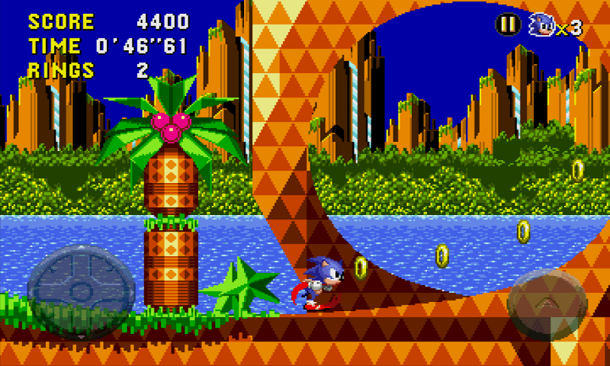
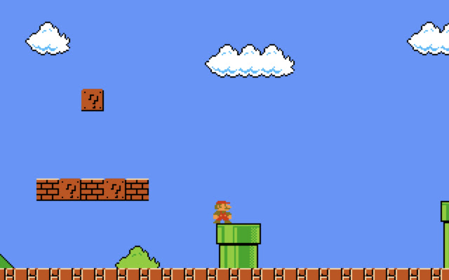
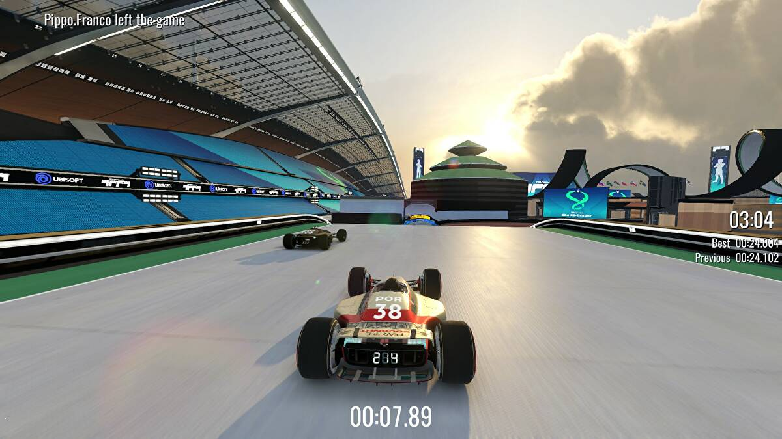
Objective
To implement the NEAT and TWEANN (Topology and Weight Evolving Artificial Neural Network) frameworks in a generally user operated video game scenario and train the AI model in such a way that it evolves overtime and implements new nodes/genomes on its own.
As the algorithm progresses, genomes (and the neural networks they produce) may get more and more complicated as a result of the reproduction and mutation procedures, which may add nodes and/or connections to genomes.

Slide 5
Dataset and Libraries
NEAT Library
PyGame Library
NEAT is an algorithm which takes a batch of AIs (genomes) attempting to accomplish a given task.
Pygame is a set of Python modules designed for writing video games. Pygame adds functionality on top of the excellent SDL library. This allows you to create fully featured games and multimedia programs in the python language.

Slide 6
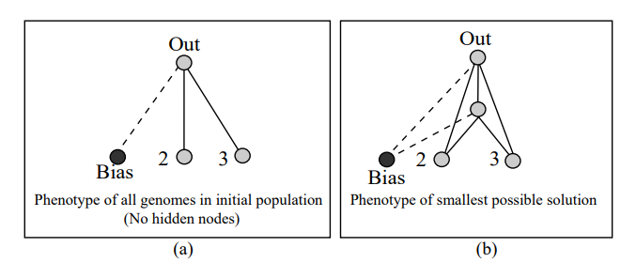
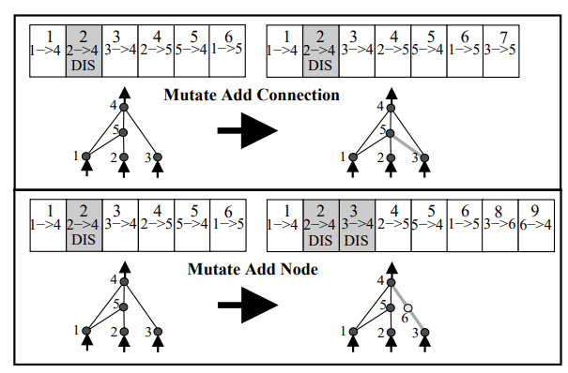
Methodology

Slide 7
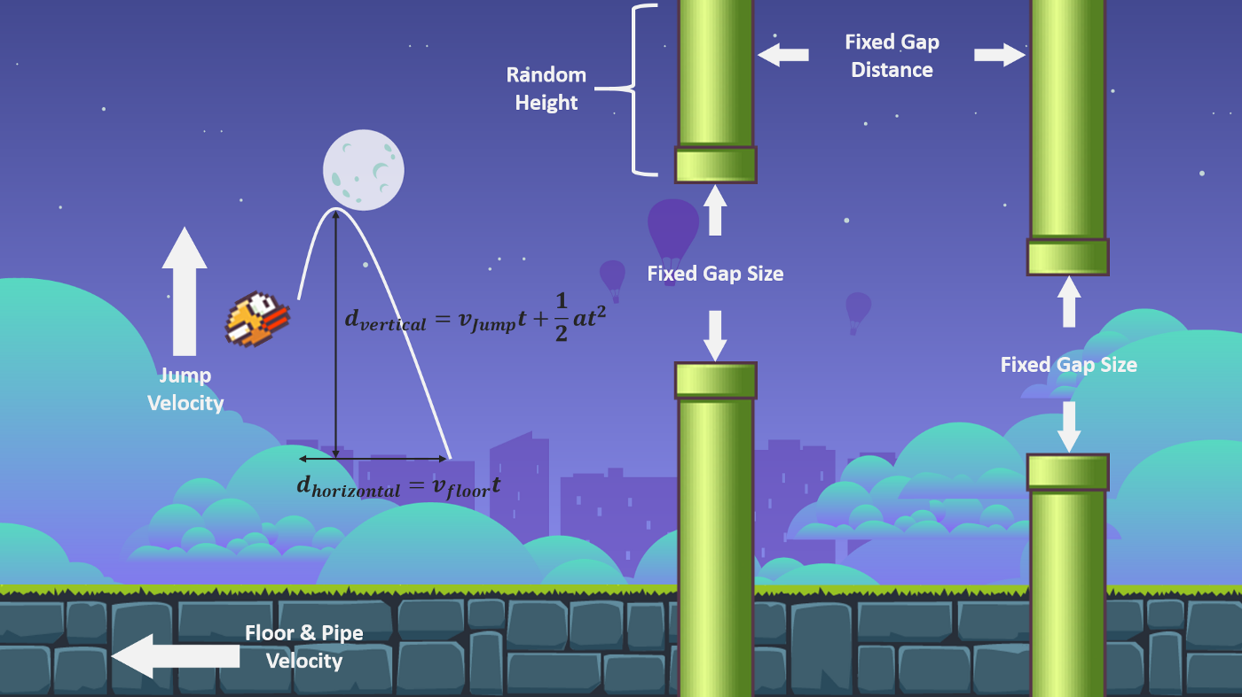
Expected Results
To build a functional AI genetic model that analyses and thinks like a human and makes the correct decisions whenever possible.

Slide 8
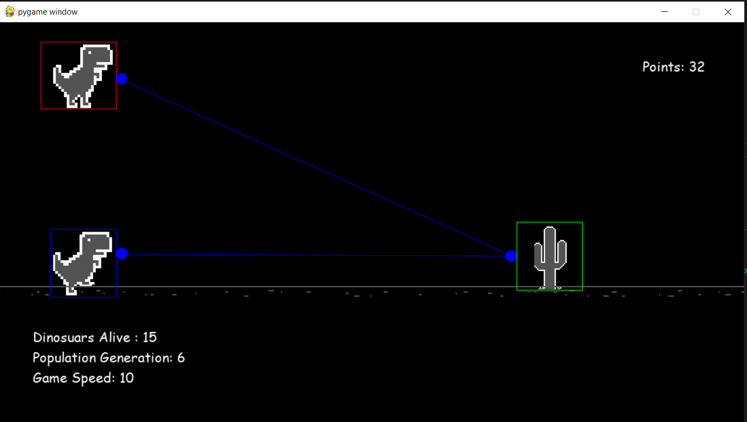

Slide 9
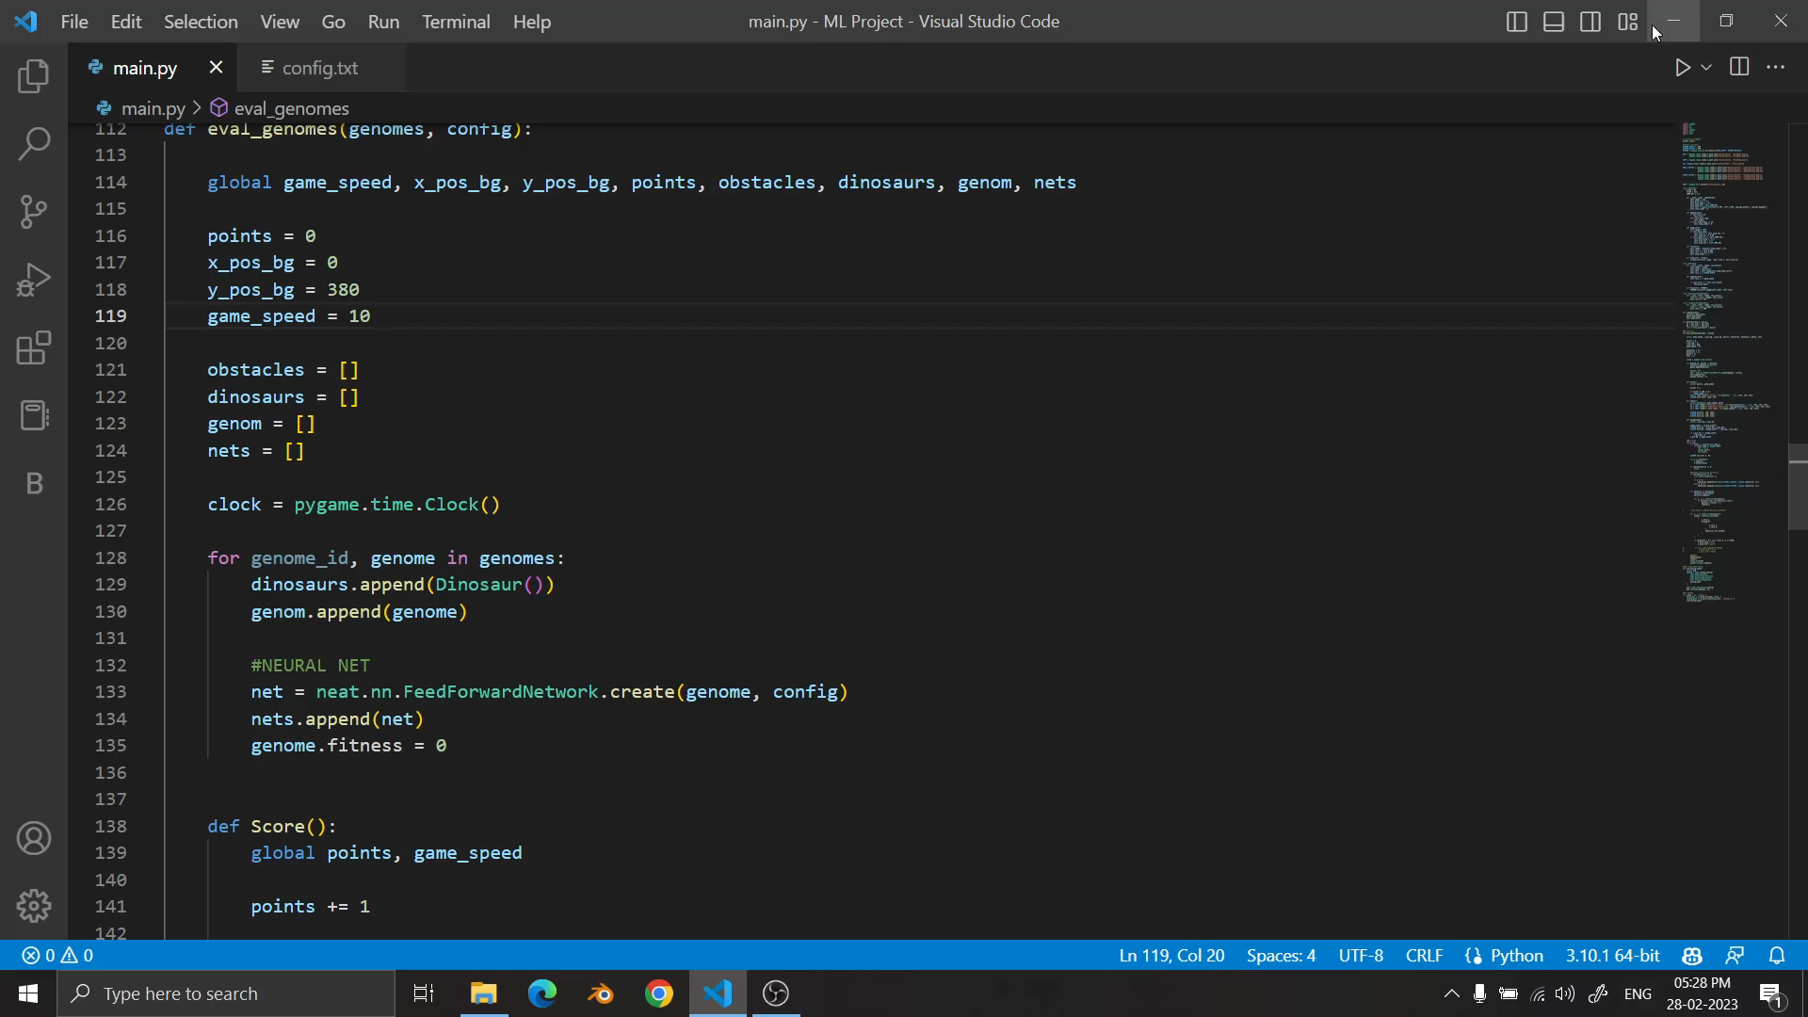

Slide 10
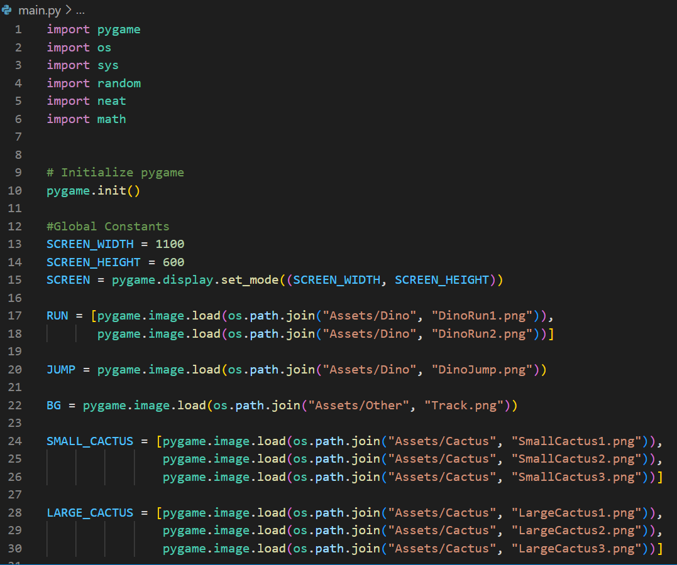
Code

Slide 11
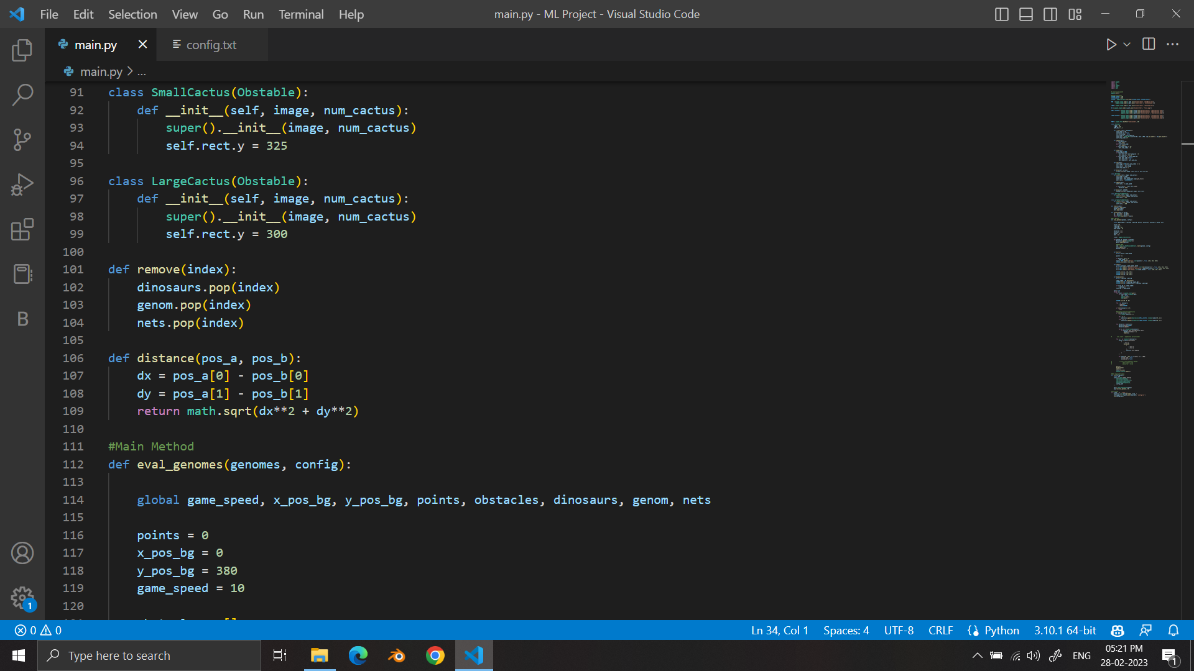
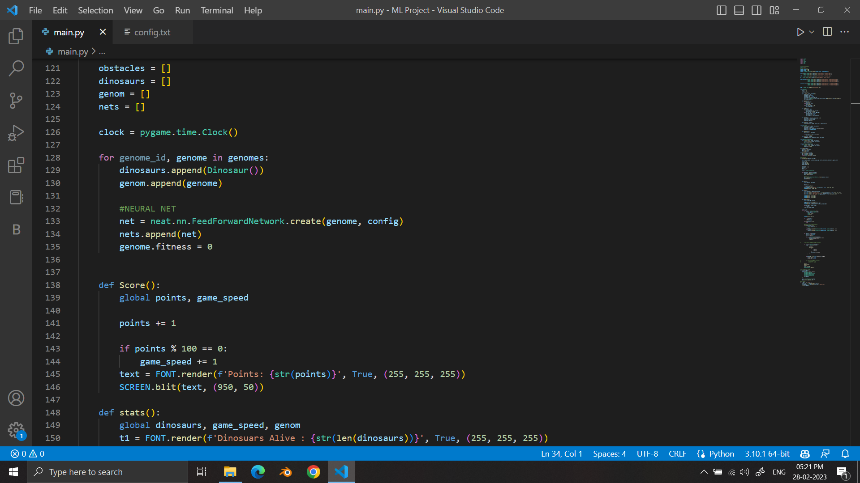
Code

Slide 12
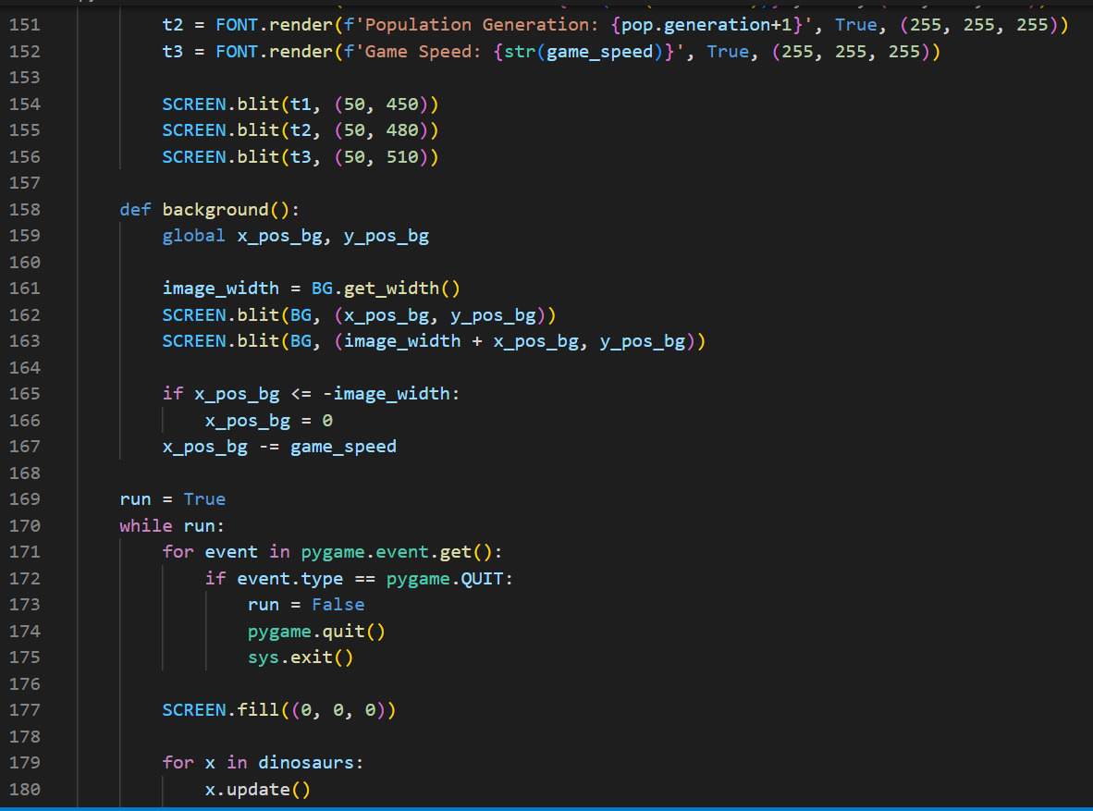
Code

Slide 13
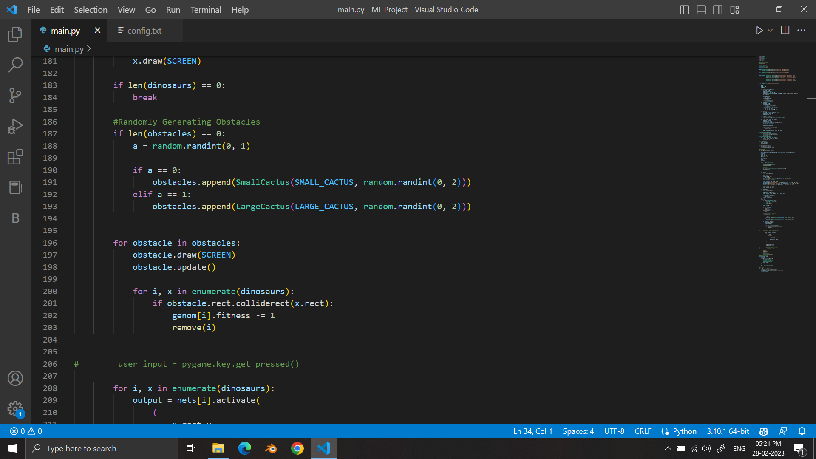
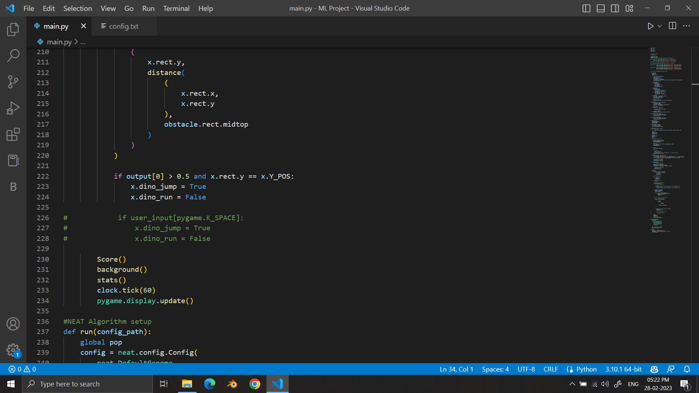
Code

Slide 14
Code

Slide 15
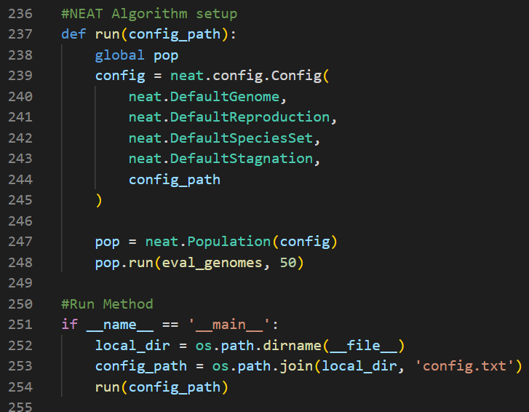
Code

Slide 16
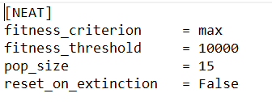
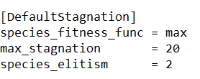
Code

Slide 17
The End

